Slide 1






Common Data Mining Methodologies
Graduate Studies

Slide 2


Learning Objectives/Topics
Overview
Common methodologies
Perform basic, common data mining techniques
Cluster Analysis
Decision/Classification Tree Analysis

Slide 3
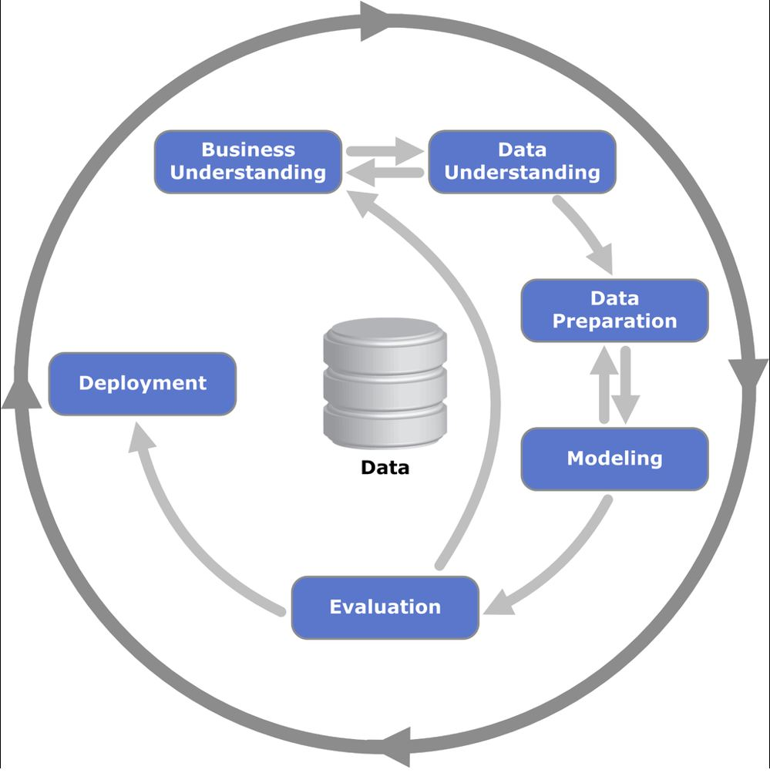
Overview
Overloaded term that might refer to methods and/or processes to extract useful knowledge from data.
Shearer, Colin. "The CRISP-DM model: the new blueprint for data mining." Journal of data warehousing 5, no. 4 (2000): 13-22.
ftp://ftp.software.ibm.com/software/analytics/spss/support/Modeler/Documentation/14/UserManual/CRISP-DM.pdf

Slide 4

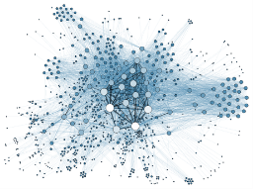

Overview
Predictive
Analytics
Unsupervised Learning / Discovery
Data Mining
Supervised Learning / Prediction

Slide 5
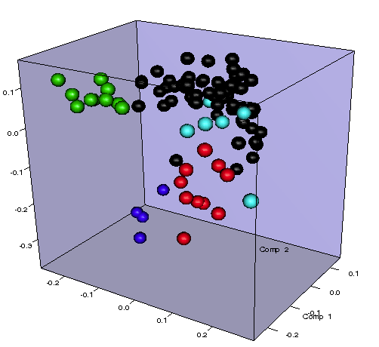
Cluster Analysis
Techniques that seeks to place objects into groups based on object similarities (or a number of dimensions).
What customers are similar and how?
What suppliers are similar and what makes them similar?
What characteristics make products similar (or different)?
Product return groups/categories.
Logistics partners.
5 clusters
Grouped based on 3 dimensions

Slide 6
Cluster Analysis
An analyst specifies the number of clusters, k.
First, all the observations are randomly assigned to one of k clusters.
Cluster centers (centroids) are calculated for each of the k clusters.
Each observation is scored as to its distance from each centroid.
Observations are reassigned to the nearest centroid.
Centroids are recalculated and the process is repeated to an optimal solution is found. Minimize the sum of the distances from the centroids.

Slide 7

Example Business Application
10,000 customers with data; age, city, income, employment status, marital status, gender, spend
100,000 prospects with data
It costs money to market your product to prospects
Where should you best target your marketing resources/efforts?

Slide 8

Example Business Application
5,000 employees with data; performance rating, education, salary, college GPA, prior work experience, projects, personality type
20 potential new hires
What are important characteristics to look for in making a hiring decision?

Slide 9
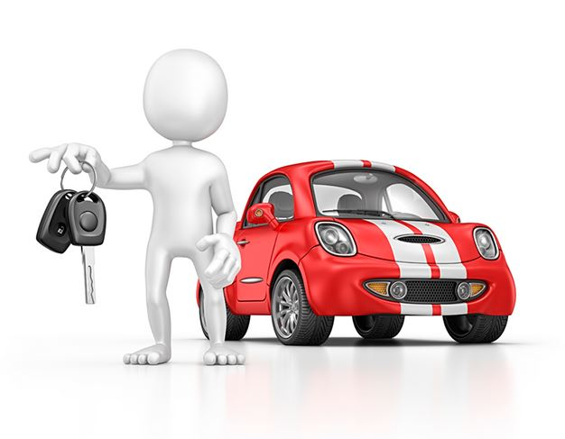
Example Business Application
1,000,000 customers with data; accident history, age, gender, education, home value, marital status, type of vehicle, claim amounts
What type of customers pose the most and least risk?
Credit worthiness, wines, suppliers, products, cities, fulfillment centers, branches, and much, much more.

Slide 10

Cluster Analysis Hands-On Applications
K-Means Method
Supplier Performance, Idea of using fixed number of clusters and centroids
Grades Example, Visualizations
Customer Segments Example, KTC-Small, Cluster Similarities and Dissimilarities, Cluster Strength

Slide 11
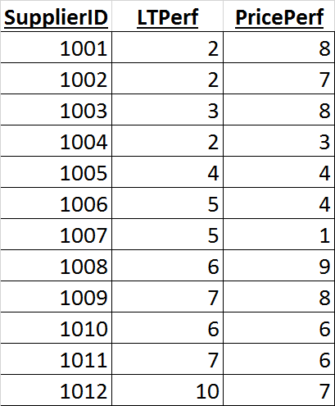
Example, Supplier Performance
12 objects (suppliers), rated on 2 dimensions/variables, lead time and price. Supplier Performance Excel file.

Slide 12
Example, Supplier Performance
great
Price performance
poor
great
poor
Lead time performance

Slide 13
Example, Supplier Performance
great
A Random Start
Analyst specifies 3 clusters or groups
Price performance
poor
great
poor
Lead time performance

Slide 14
Example, Supplier Performance
great
Cluster centroids/centers are calculated
Price performance
poor
great
poor
Lead time performance

Slide 15
Example, Supplier Performance
great
A pass of reassignments are made based on the centroids
Price performance
poor
great
poor
Lead time performance

Slide 16
Example, Supplier Performance
great
New centroids are obtained and the total sum of squared errors is calculated.
Price performance
poor
great
poor
Lead time performance

Slide 17
Example, Supplier Performance
great
The process iterates
Price performance
poor
great
poor
Lead time performance

Slide 18
Example, Supplier Performance
great
Sum of squared distances in clusters is minimized.
This total metric is reported.
Price performance
poor
great
poor
Lead time performance

Slide 19
Example, Supplier Performance
great
Price performers
Price performance
Best of breed
Poor Performers
great
poor
poor
Lead time performance

Slide 20
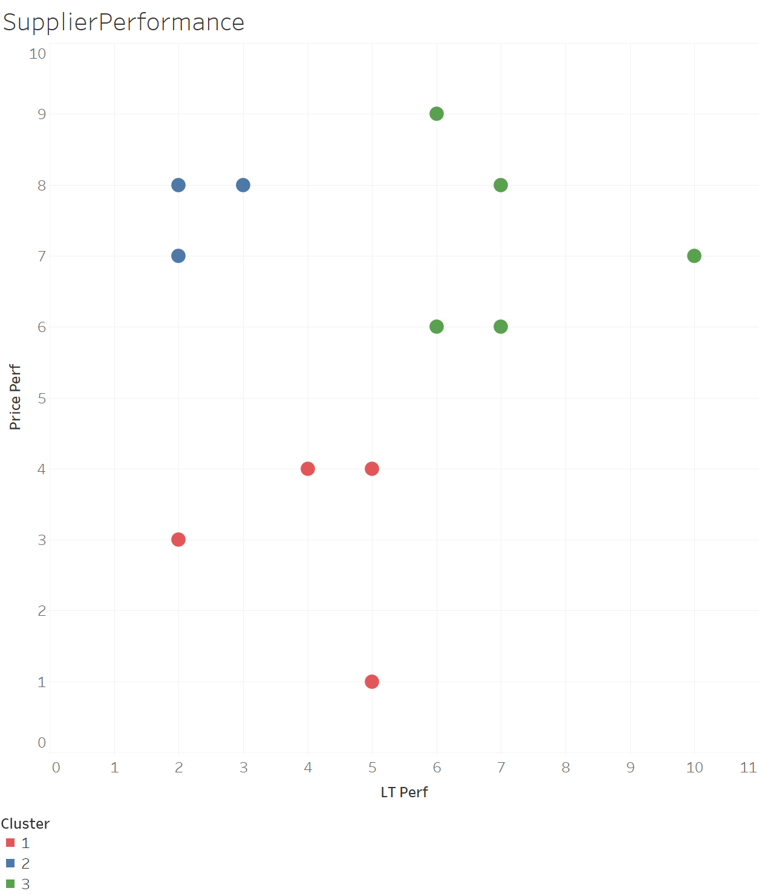
Example, Supplier Performance

Slide 21
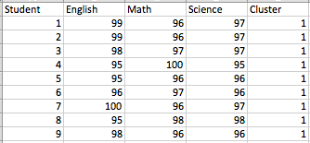
Cluster Analysis, grades_km_input
This column added after the cluster analysis was run.
Data Set
619 observations
3 attributes

Slide 22


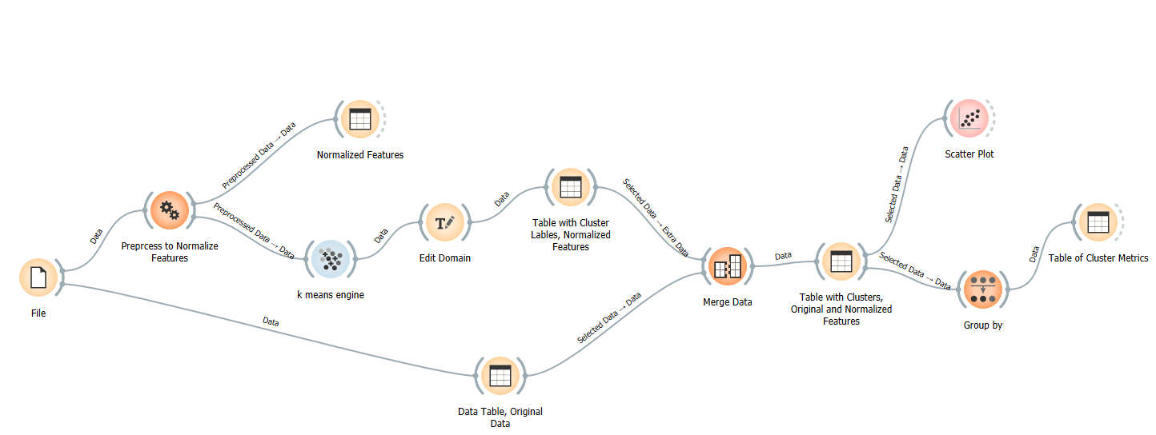
Cluster Analysis, K-means

Slide 23
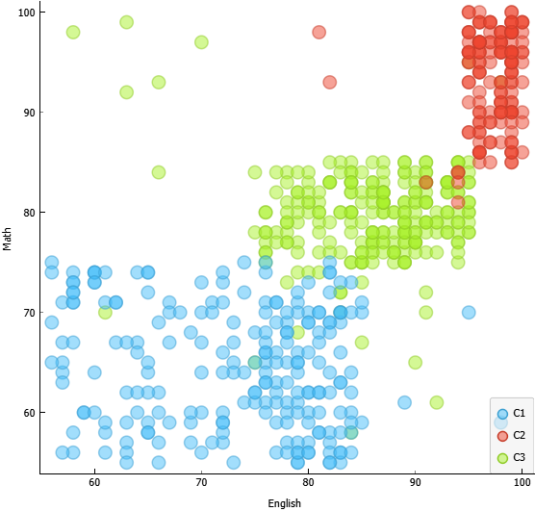
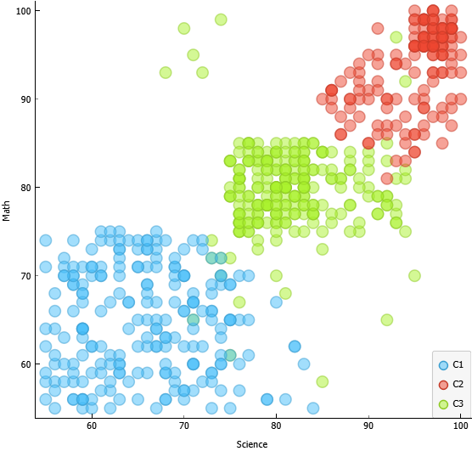
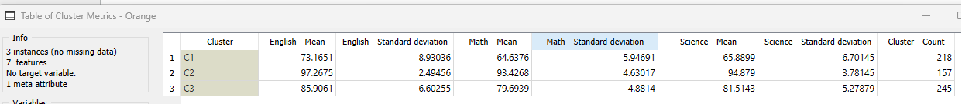
Cluster Analysis, K-means
C2 is the tightest or least dispersed cluster, with the best scores. C1 has the most dispersion within its group and has the lowest scores. C3 is the middle performing group and has quite a bit of dispersion within its group as well. Groups C2 and C1 are the most different from one another.

Slide 24
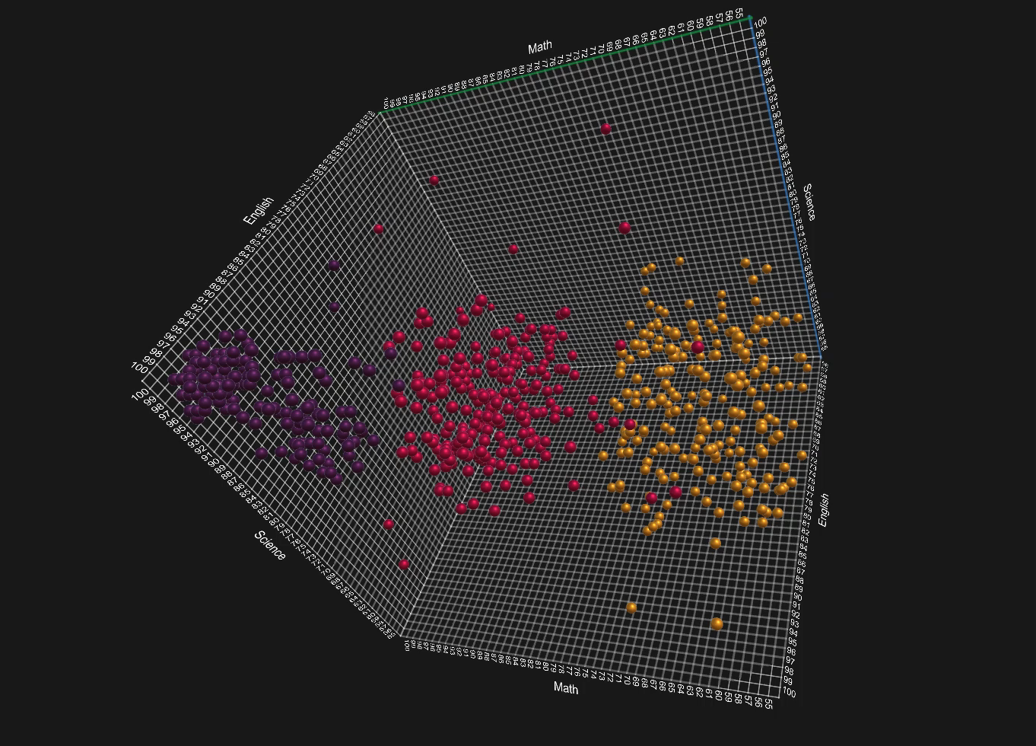


Cluster Analysis, K-means

Slide 25
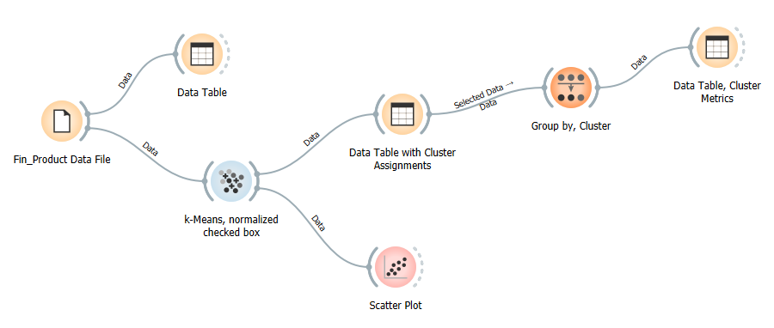
Customer Segments Application Financial Product/Instrument Marketing

Slide 26
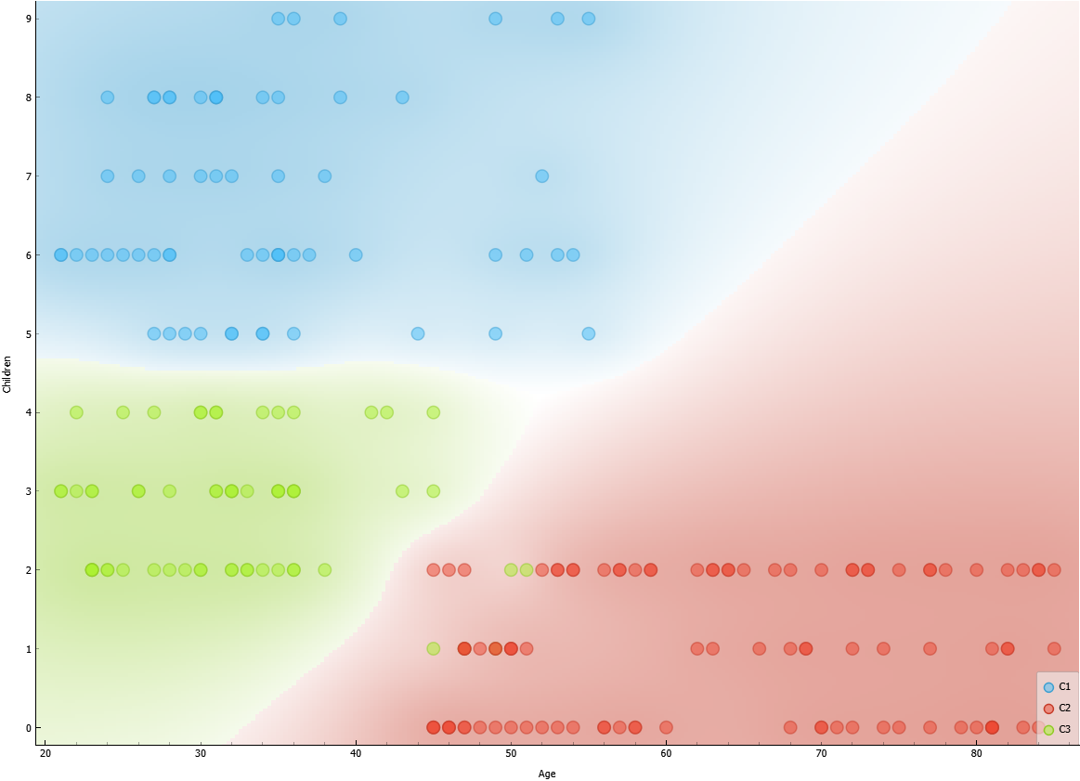
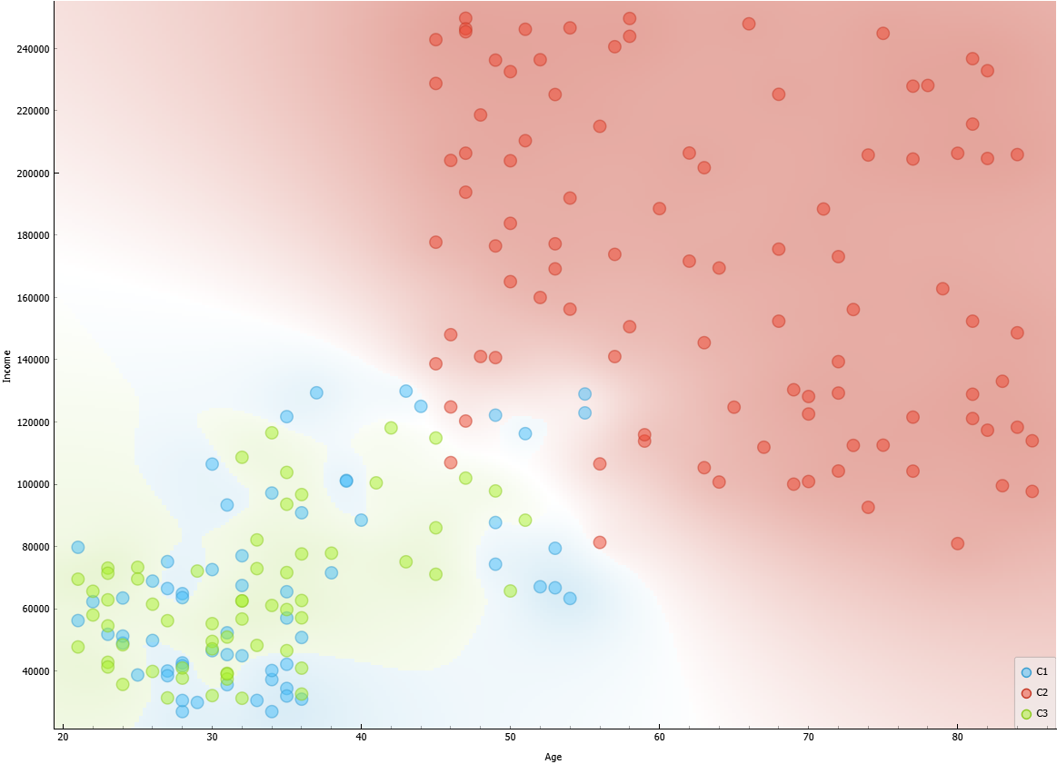
Customer Segments Application Financial Product/Instrument Marketing
C3 is the tightest or least dispersed cluster, this group is young, a medium number of children, lowest income.
C1 has a lot of children compared to the other groups, this group has a relatively low income, and is middle to younger in age. C2 is the largest income group, oldest, and least number of children. In this group there is quite a bit of dispersion in incomes and ages, but generally older with higher incomes.
C1 and C3 are similar, with the distinguishing attribute being number of children much larger in C1.

Slide 27
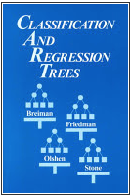



Decision/Classification Trees
Many implementations/decision tree methods, CART is the leading decision tree modeling standard. Developed and documented in 1984.
Classification Trees
Did your wife see you?
YES
NO
Was it expensive?
Eat It
YES
NO
Can you cut off the part that touched the floor?
Is it bacon?
YES
NO
YES
NO
Eat It
Eat It
Don’t Eat It
Eat It

Slide 28
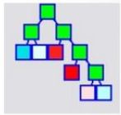
Decision/Classification Trees
CART, Classification And Regression Trees
Separates relevant from irrelevant predictors
Easy to understand results
Doesn’t require attribute transformations
Assumption free
Results not effected by outliers, units, or scale
Foundation for many other data mining classification techniques such as random forests, boosted decision trees, bagged decision trees, others

Slide 29
Decision/Classification Trees
Buy or not
Credit approvals
Employee last more than a year, employee tenure/success
New product introduction, hit or miss
Click or not click on an ad
Republican or democrat
Will churn, won’t churn

Slide 30
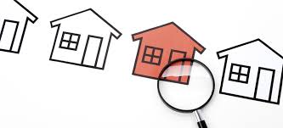
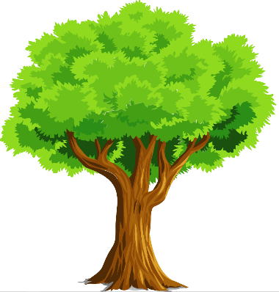

Decision/Classification Trees
amount/balance outstanding
number of payments made
term
credit score change
marital status
change

Slide 31
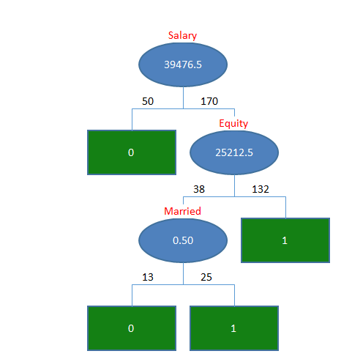
Decision/Classification Trees
Root and interior nodes contain a simple test of an attribute. Decision nodes.
Every data point (or observation in a data set) will correspond to one and only one path in the tree, and thereby to one and only leaf or terminal node.
Each leaf contains a “classification” for its segment. Classification (or decision) trees are supervised learning method since each leaf contains a “target” value.
We use the tree to make a prediction with an example for which we do not know its classification value.
Root node
Interior nodes
The number of observations along a path in either the training or validation data set.
Leaf or terminal nodes

Slide 32

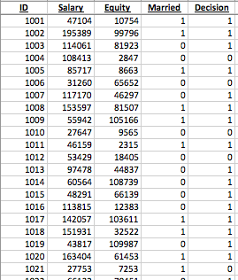
Decision/Classification Trees
Classification Analysis

Slide 33
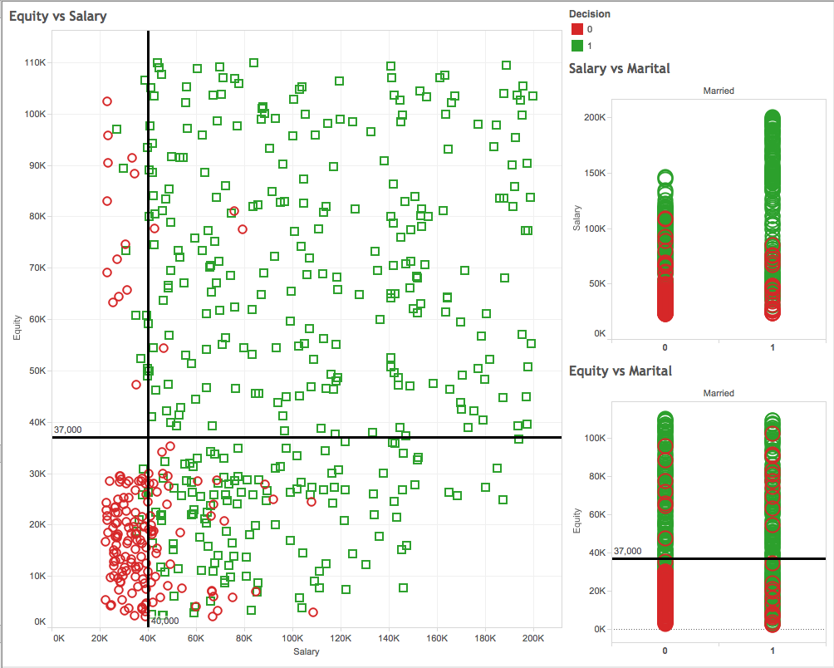
Decision/Classification Trees
Classification Analysis

Slide 34
Decision/Classification Trees
Data Mining Process
Data Set
550 Instances
Standard Data Partition
Split Data
Training data set
Validation data set
330 Instances
220 Instances
Model Build
Evaluate Model
Deploy Model
Make Predictions

Slide 35
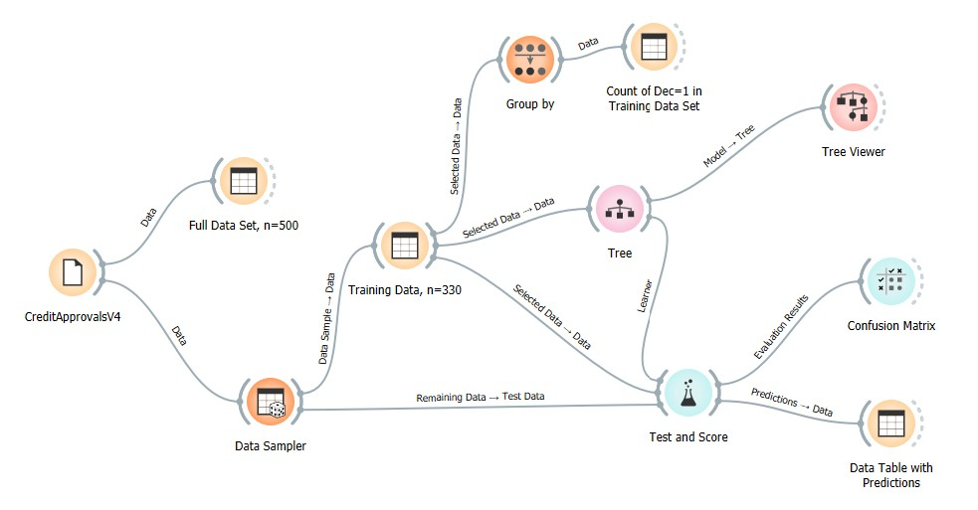
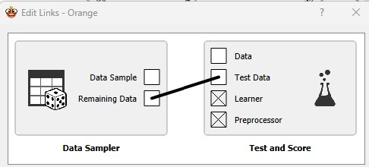
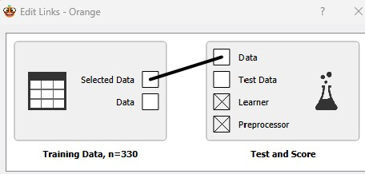


Decision/Classification Trees

Slide 36
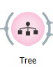
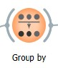
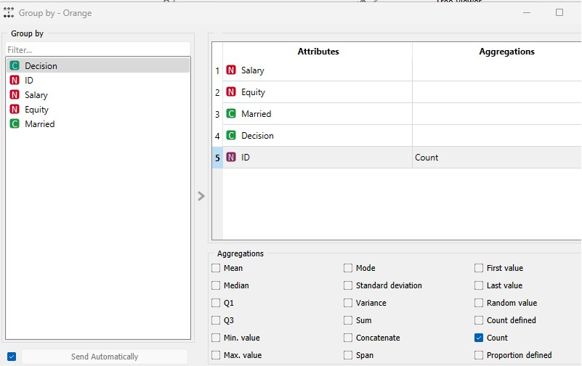
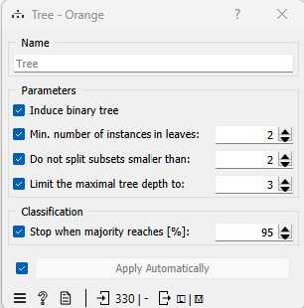
Decision/Classification Trees

Slide 37
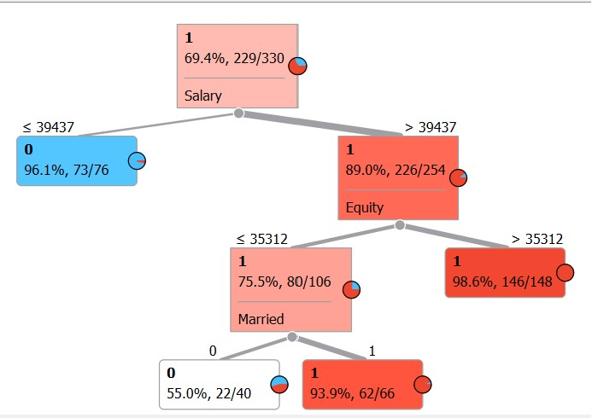
Decision/Classification Trees shows the training data

Slide 38
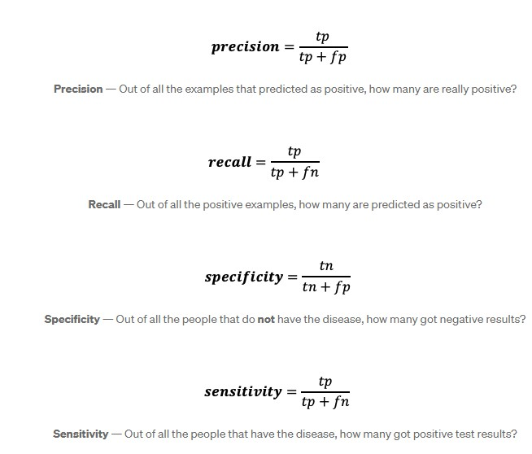

Decision/Classification Trees validation data set

Slide 39
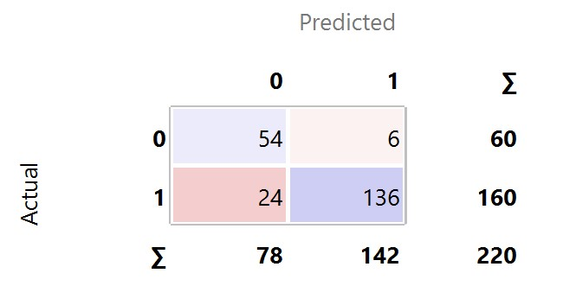

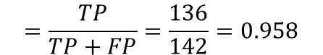


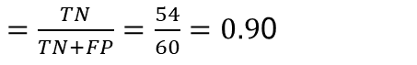


Decision/Classification Trees validation data set
Overall Accuracy Classification Accuracy
$$=\frac{TN+TP}{Total}=\frac{54+136}{220}=0.864$$
Specificity
$=\frac{TN}{TN+FP}=\frac{54}{60}=0.9$0
Precision
$$=\frac{TP}{TP+FP}=\frac{136}{142}=0.958$$
Sensitivity Recall
$$=\frac{TP}{FN+TP}=\frac{136}{160}=0.85$$

Slide 40
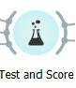
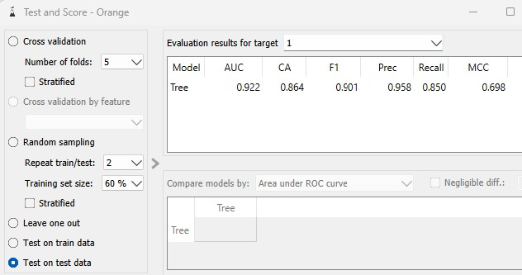

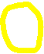

Decision/Classification Trees validation data set

Slide 41
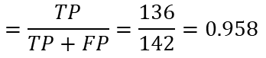
Decision/Classification Trees validation data set
Given the model says “approve”, what is the probability this was a correct decision? Precision.
$$=\frac{TP}{TP+FP}=\frac{136}{142}=0.958$$
The Precision!
Given the model says “deny”, what is the probability this was a correct decision?

Slide 42
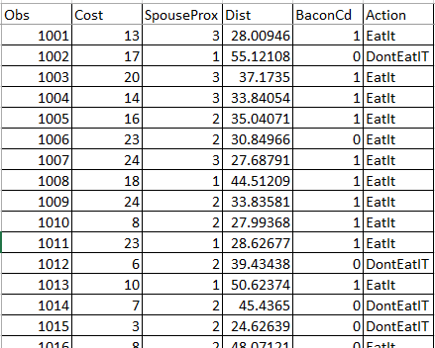
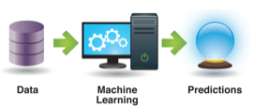
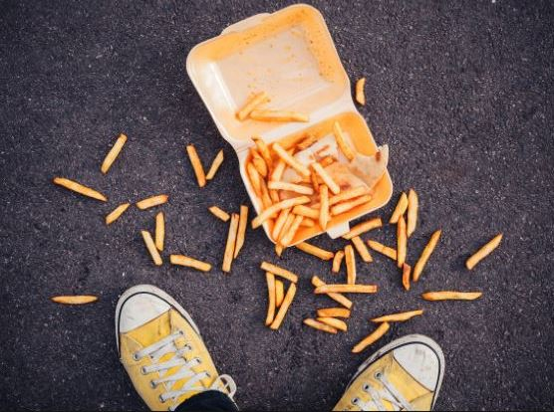
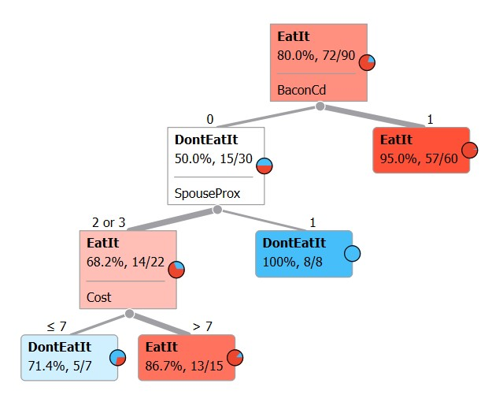
EatIt Example
150 observations/instances/records/rows
1 categorical target
4 attributes/predictors/fields/columns

Slide 43
Machine Learning Decision/Classification Tree Example
Selecting records at random, the records or broken into 2 categories.
A training data set, typically 60% of the data
A validation data set, typically 40% of the data
This break down is called a “partition, split, or sample”.
The Machine Learning Methodology (in this case Decision/Classification Tree) creates a model of the training data set.
Using the created model, the validation instances are classified and a comparison is made for each record; model classification of the record versus original data classification for the record.
A summary of the model’s performance with the validation model is provided in the confusion matrix.
Using the Machine Learned model predictions are made on new instances or records.

Slide 44
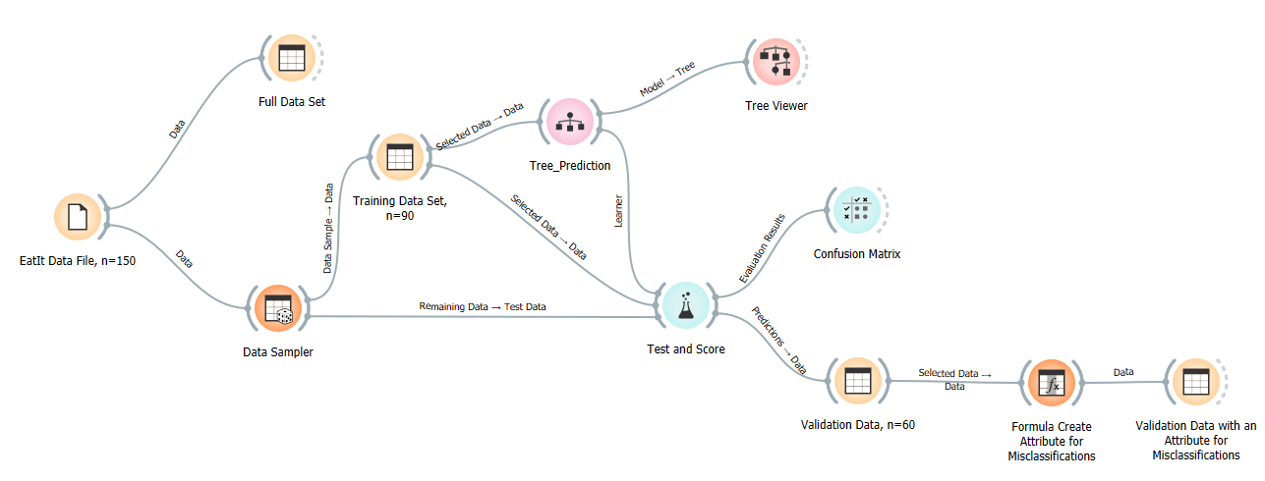
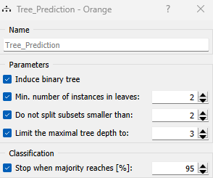
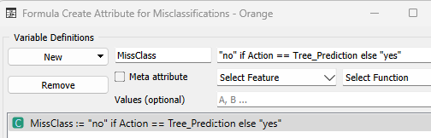
Eat It Example, workflow

Slide 45
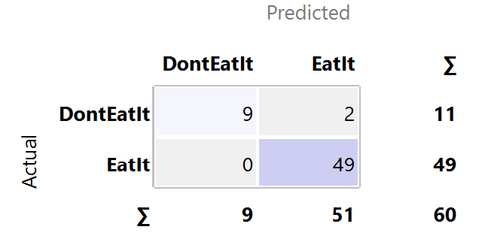
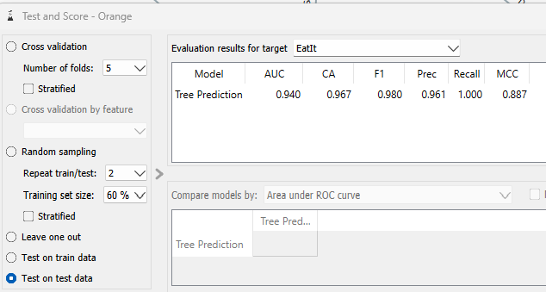



Eat It Example validation data

Slide 46
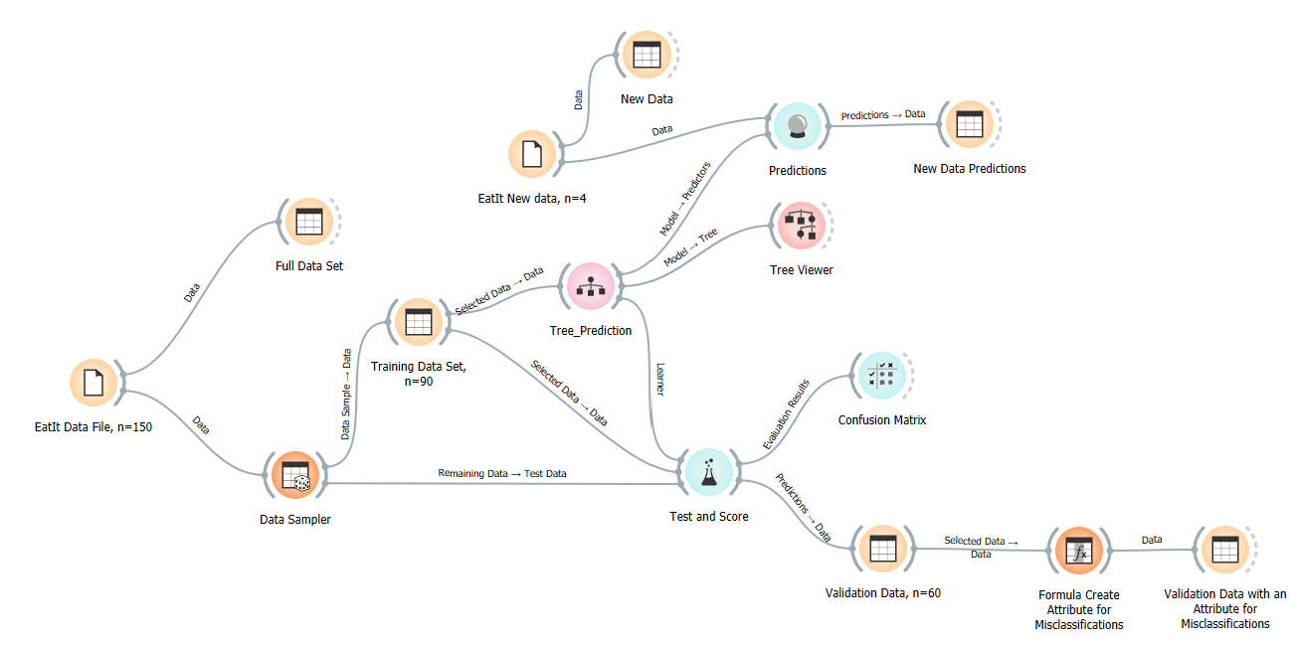
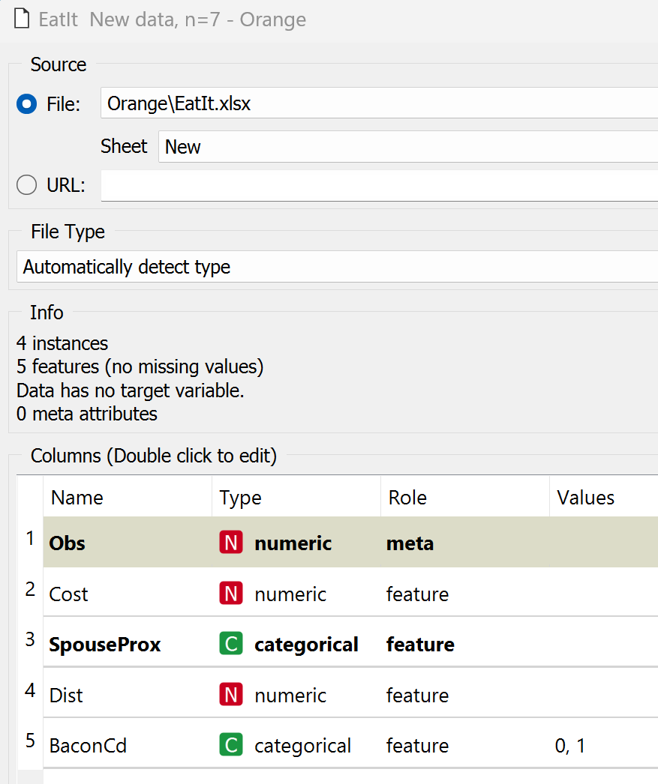
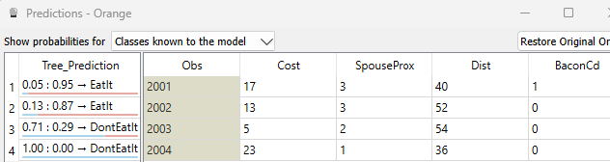


Eat It Example, new data to classify

